Slide 1
ME 140L Final Project
Andres Barrios and Rhea Patkar

Slide 2
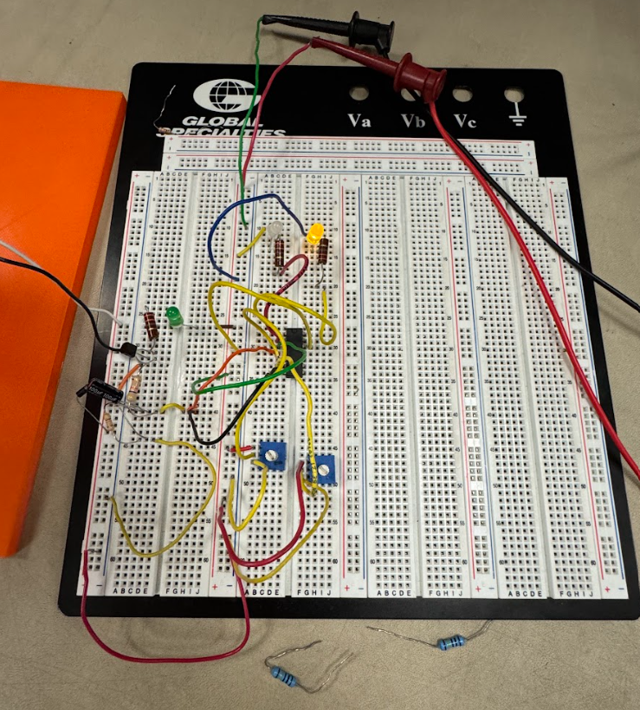
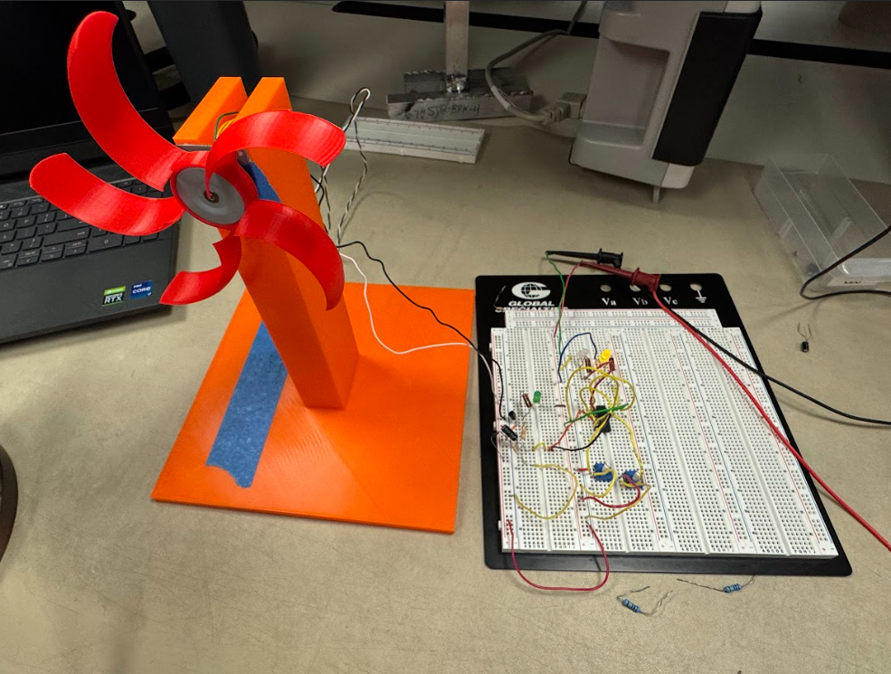
Functionality + Circuit Overview
Photos of Setup:
Components Used:
1 Diode
1 Capacitor (1 100µF)
5 Resistors(2 330Ω and 3 47Ω)
2 Potentiometers (2 10kΩ)
3 LEDS
1 Comparator (LM339N)
1 Generator

Slide 3
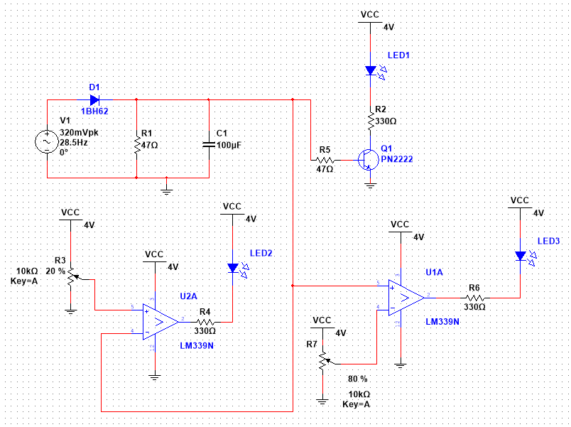
How it Works
The wind turbine generates AC power by converting mechanical energy into electrical energy via the generator. This AC power is then converted to DC through a half-wave rectifier, which uses a diode to allow current to pass in only one direction. To smooth out the fluctuating DC output, a capacitor is added.
The smoothed DC output is then connected to a transistor and two comparators. When current flows into the transistor’s base, it triggers a larger current from the collector to the emitter, amplifying the current to control the brightness of a gradual LED. This allows us to visually track voltage changes through the LED.
The high-speed LED is controlled by one of the comparators, which compares the DC output (reference voltage) to the 4V source set by the potentiometer (input voltage). When the reference voltage (DC output) exceeds the voltage set by the potentiometer, the comparator outputs a low signal (false state), allowing current to flow and lighting the LED. For the low-speed indicator, the setup is reversed: the 4V source, regulated by the potentiometer, serves as the reference voltage, while the DC output acts as the input. As the speed of the fan increases (AC voltage and DC voltage increases), Vin > Vref and comparator outputs a high signal. Therefore, there will be no voltage drop across the low-speed indicator LED, thus is will turn off.
Circuit Analysis
Half-Wave Rectifier
Gradual
High Speed
Low Speed

Slide 4
Experimental Data and Evaluation
 | Low | Middle | High
DC | 0 - 0.85 V | 0.85 - 1.47 V | 1.47 - Infinity V
AC | 0 - 1.97 V | 1.97 - 2.65 V | 2.65 - Infinity V
The circuit design worked as expected. Thresholds for each values were taken using the multimeter. When the fan is not spinning, the low speed LED is on until the DC output voltage reached 0.85 V. As the speed increases, the AC and DC voltage output increases. The period termed as “middle” speed is where both LEDs are switched off before the high LED turns on. Once the DC voltage reaches 1.47 V, the high voltage light turns on and stays on as the speed of the fan reaches its maximum.

Slide 5
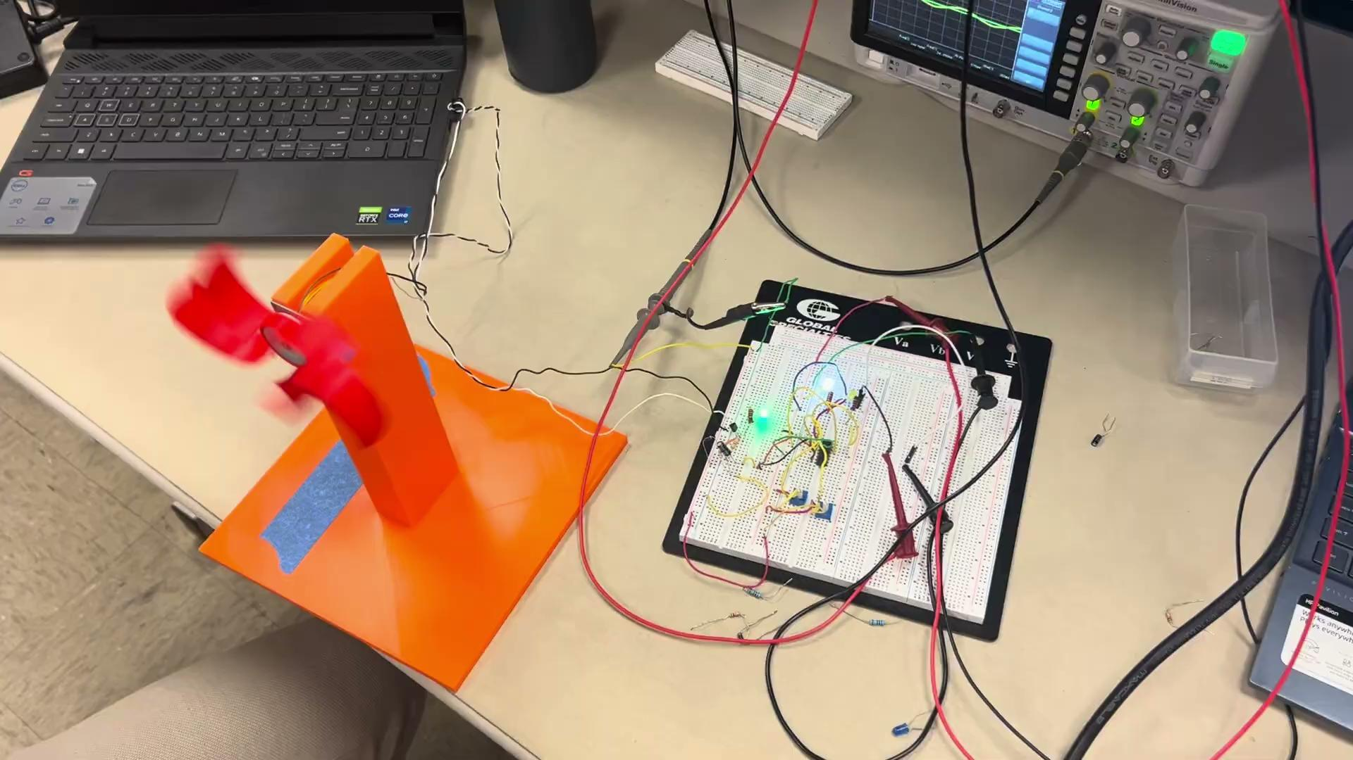
Video of Functioning Circuit

Slide 6
Key Takeaways
Difficult Encounters:
Flickering and sensitive gradual LED
Adjusting the potentiometer setting to hit high speed and low speed bounds
Lessons Learned:
Adding a higher capacitance, further smoothens the AC voltage when converting to to DC. This helps with the possible flickering of the gradual LED, allowing for a smooth transition as the fan speed differs. To adjust the sensitivity on the gradual LED, we can adjust the resistance in the circuit to allow for less current to pass through the base when the fan first begins to spin. In addition, we learned how to use multiple comparators within a single chip to simplify out circuit display.
Conclusions:
Through this project, we were able to understand the design process of a multifunctional circuit. First, using a software like multisim can be helpful to create a design to meet general requirements. Then, during the implementation and testing phase, we can manipulate parameters like resistances or potentiometer settings to achieve functionality specifications. The skills learned in the process of preparing this circuit and designing it to fit the specifications required are some that can be applied to many other situations delving into mechatronic system design and analysis.

